Slide 1
Stable Diffusion
Accelerate Programme for Scientific Discovery

Slide 2
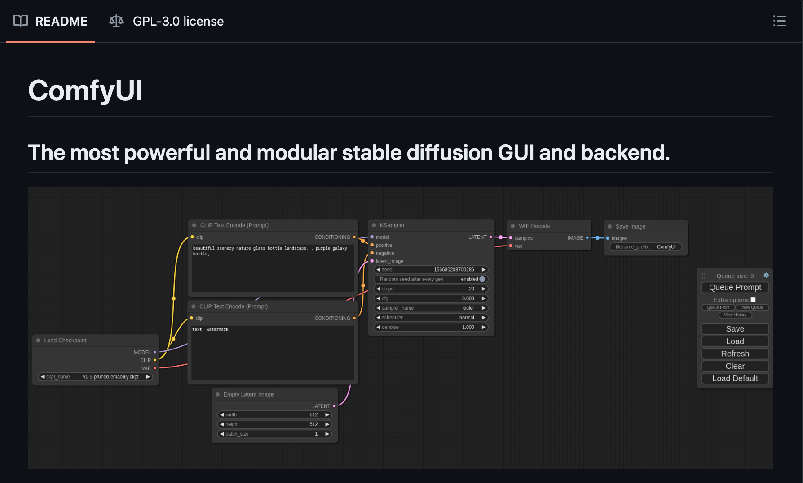



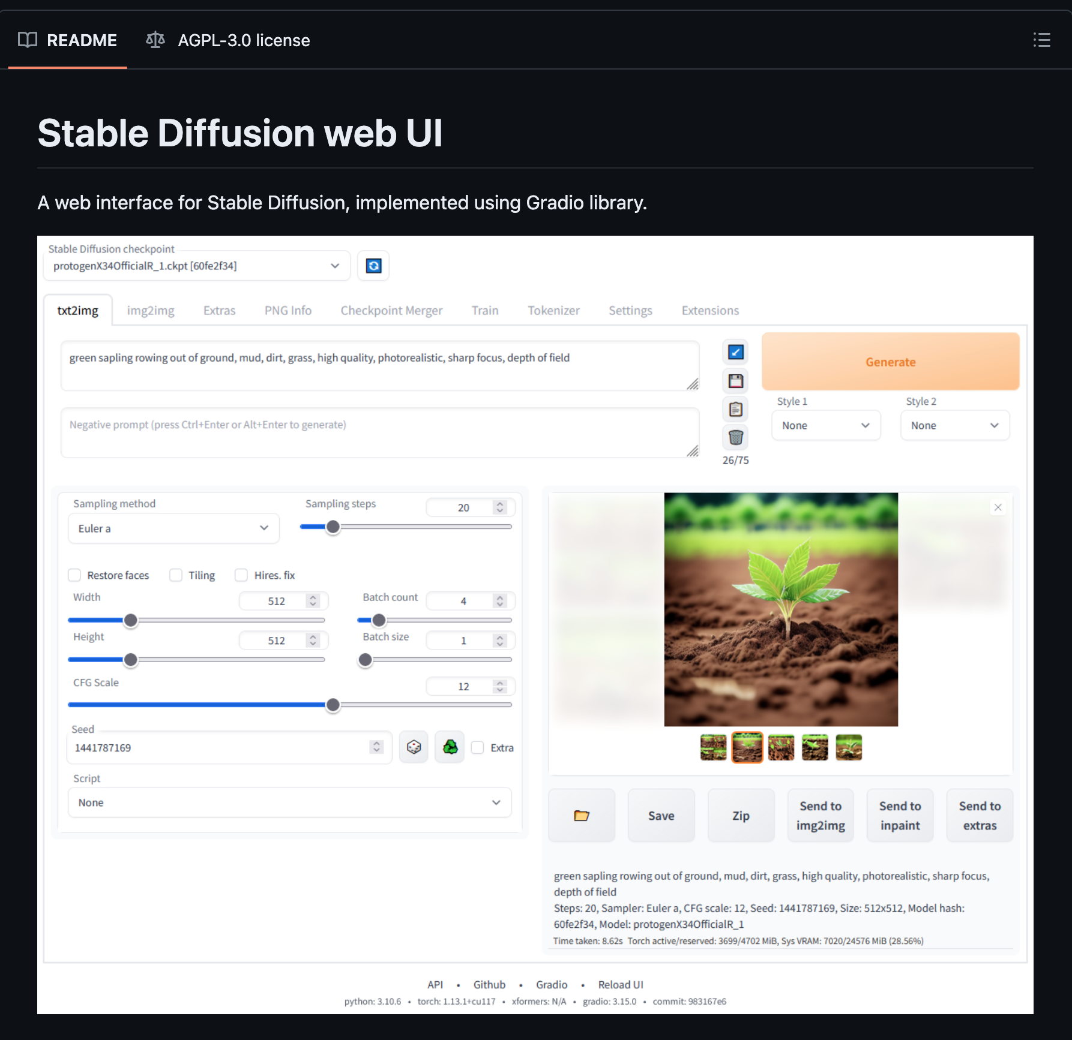

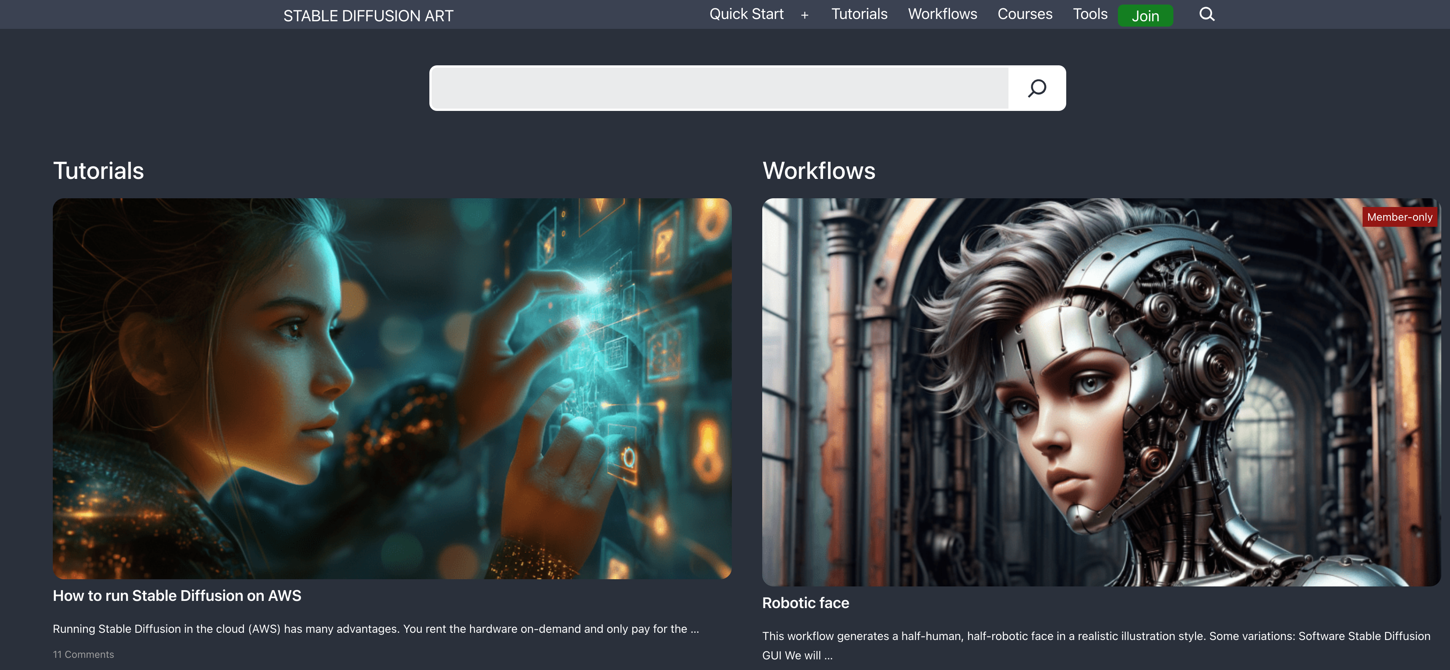


Stable Diffusion
Stable Diffusion highlights the power of open source
A rich and varied community has rallied around open source models…

Slide 3
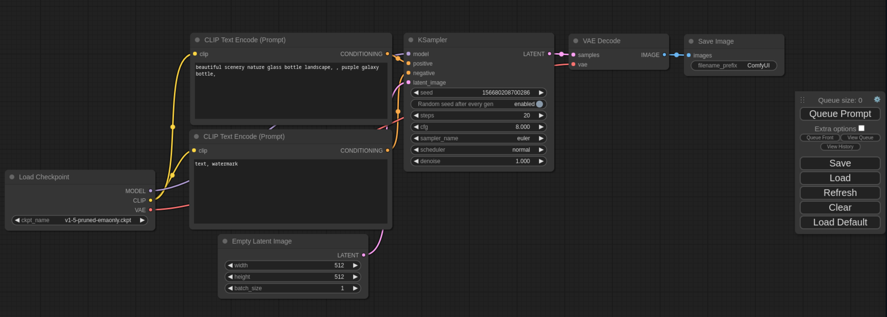
Stable Diffusion
ComfyUI
Notes:
ComfyUI is a user interface that closely follows the way Blender works. If you haven’t used blender before, it’s 3D modelling software.
ComfyUI is a node-based GUI for Stable Diffusion. You can construct an image generation workflow by chaining different blocks (called nodes) together.
It allows you to configure nodes and create some cool stuff - all of the additions we talked about 2 weeks ago, are all present here in the UI.

Slide 4
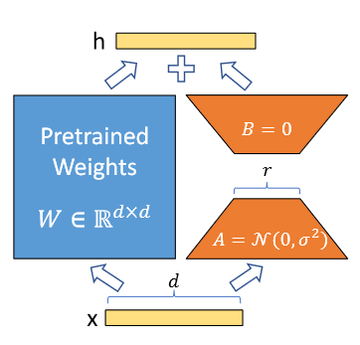
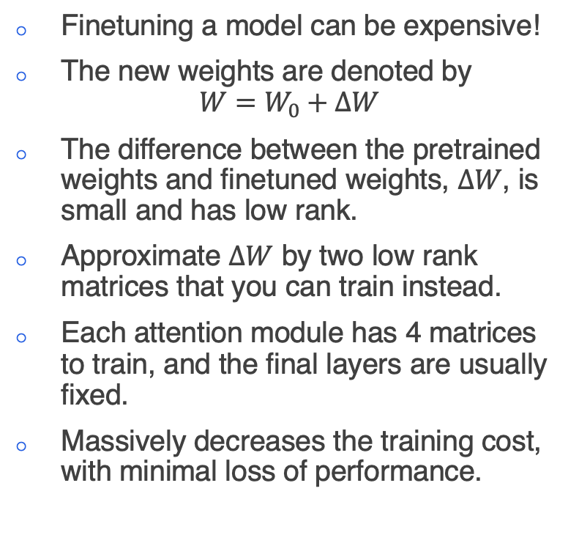
LoRA
Finetuning a model can be expensive!
The new weights are denoted by
$$W=W_{0}+ΔW$$
The difference between the pretrained weights and finetuned weights, $ΔW$, is small and has low rank.
Approximate $ΔW$ by two low rank matrices that you can train instead.
Each attention module has 4 matrices to train, and the final layers are usually fixed.
Massively decreases the training cost, with minimal loss of performance.
Notes:
Intro to LoRA:
PEFT Library

Slide 5
Code
Accelerate Programme for Scientific Discovery

Slide 6
Code
As part of the workshop we have put together some short examples
Autoencoders and VAEs
Simple CLIP
U-Net
DDPM

Slide 7
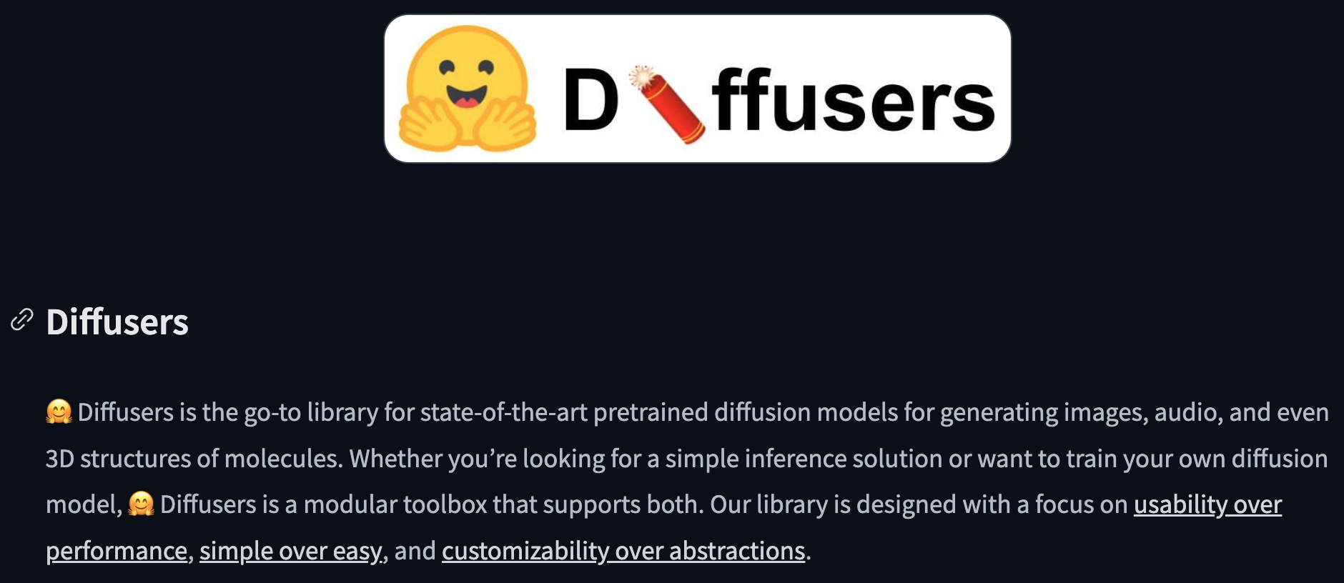
Hugging Face Diffusers
Fortunately, Hugging Face has done a large amount of the work for us…

Slide 8
Hugging Face Diffusers
Diffusers offers a wide range of easy to build models…
UNet1DModel
UNet2DModel
Options for conditioning

Slide 9
Additional Information
What do you think could be covered…?

